Slide 1
ECE387: INTRODUCTION TO ROBOTIC SYSTEMS
“What is a robot?”
Class webpage: https://marsuniversity.github.io/ece387/
Book mark it NOW!!!!

Slide 2
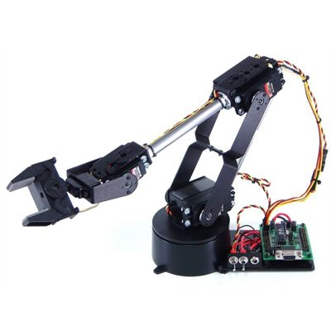
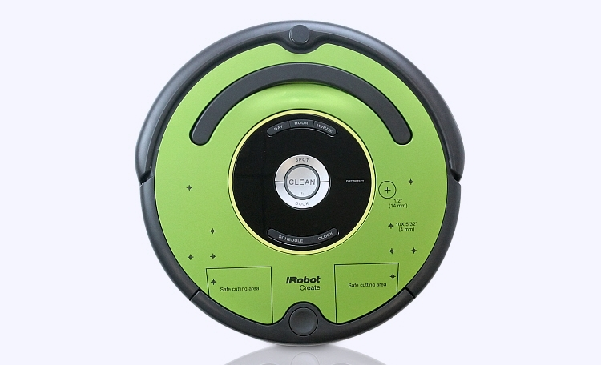
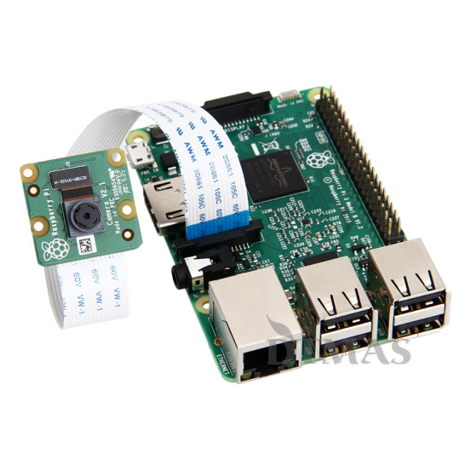
Course Content
Basics:
Linux
Python
Robot Arms:
Forward/inverse kinematics
Vision Systems:
Camera systems
Image processing
Computer vision
Mobile Robots:
Mobile robot systems
Sensors
Control and planning
I will NOT cover all of the material, you need to read the lessons and make sure you understand

Slide 3
What are you going to do?
2 GR’s and 5 Quizzes
5 Labs (Arm, Vision, and Roomba)
1 Final Project
Every lesson has Exercises and Questions
Quizzes will come from these!
GR questions will come from: homework, quizzes, and labs
Homework (HW) supports labs
Group work: labs
You need to be here for labs (at least one day), no make-ups
Individual work: HW and GRs/Quizzes
You can only get an instructor’s help
No git, everything will be printed out and handed in either at the start or end of class
Find a local printer you can print to, follow the instructions on the printer to add it
Make sure you understand the labs … don’t let your group do it!

Slide 4
Expectations
We will cover a lot of material and move fast
Keep up!
Since this is an undergrad class and an introduction class, we will not learn a lot of the details behind things.
Legos: I expect you to know how things go together and how to use the tools
I do not expect you to be able to derive algorithms from first principles
Kinematics will be the only place where you need to understand the lower level math to move the robot arm
Wait until grad school to learn how to derive these yourself
Lots of programming!!!
Every quiz/GR will have python/linux material on it
For every reading, answer the questions and do the exercises … those are good examples of quiz/test questions

Slide 5
Movies
Darpa Robot Challenge
Darpa Robot Fails
Walking Robot

Slide 6
Tools
Linux
Already installed on robots, custom version of Raspbian for this class
We will use git-bash to emulate on Windoze
Python 2.7.x
OpenCV 3.3.x
Jupyter notebooks
Please make sure you install the required tools ASAP so we can handle any install issues

Slide 7
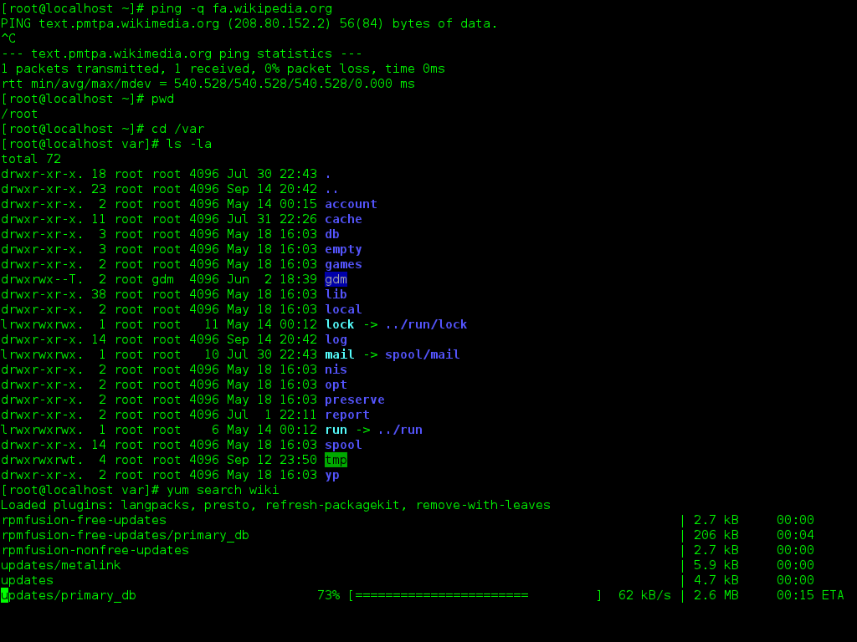
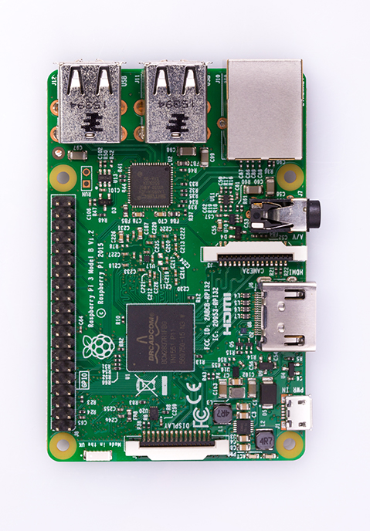
Linux and the Command Line

Slide 8
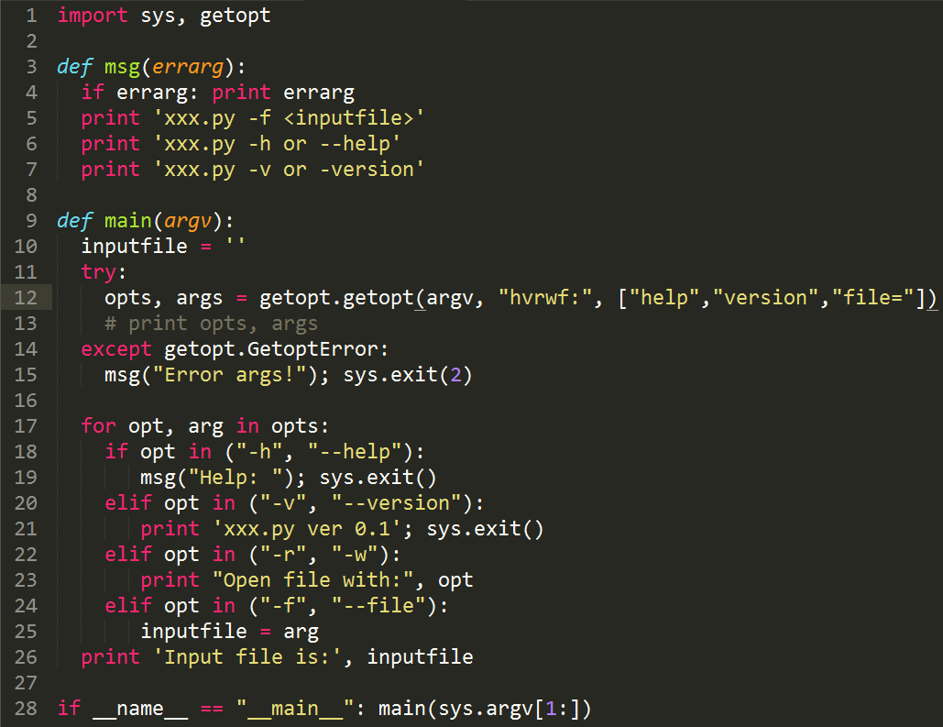
Python

Slide 10
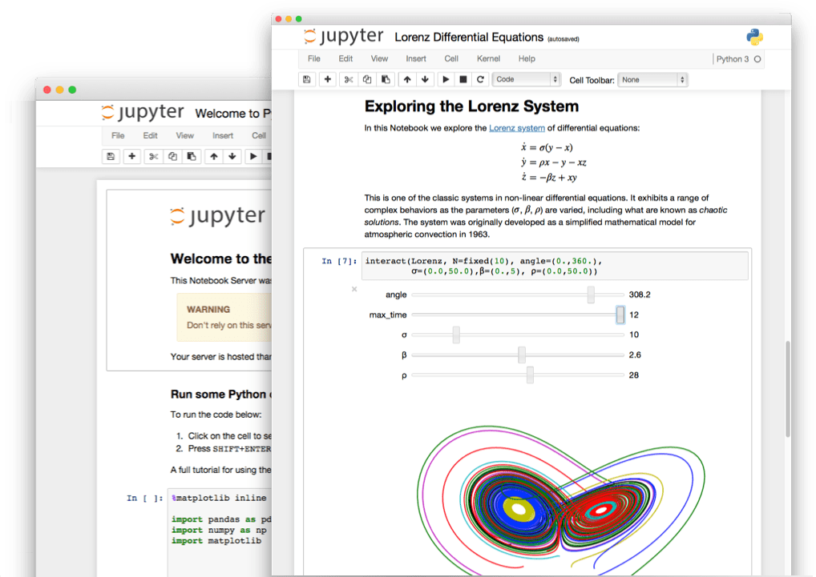
Jupyter Notebook
Markdown syntax to write and LaTeX for equations
Executable python code which runs in real time
Almost the entire course is written in a Juptyer notebook, so you can edit and play with code! You will use the notebooks to submit some homework and labs.

Slide 11
Let’s look through the website https://marsuniversity.github.io/ece387/
Can you guess the TV show my github repos are based off of?

Slide 12
Backups

Slide 13
Definitions
Robot: a device that automatically performs complicated often repetitive tasks
Cyborg: a person whose body contains mechanical or electrical devices and whose abilities are greater than the abilities of normal humans (bionic human)
Android: a mobile robot usually with a human form

Slide 14
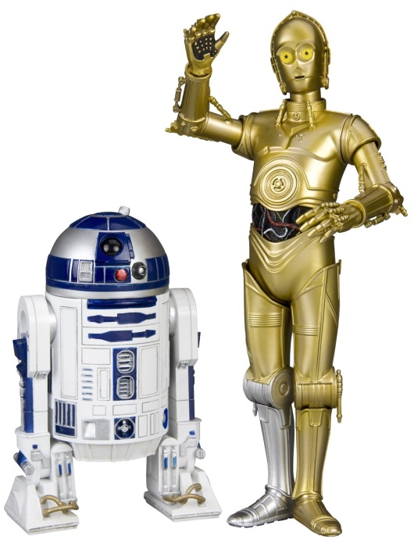
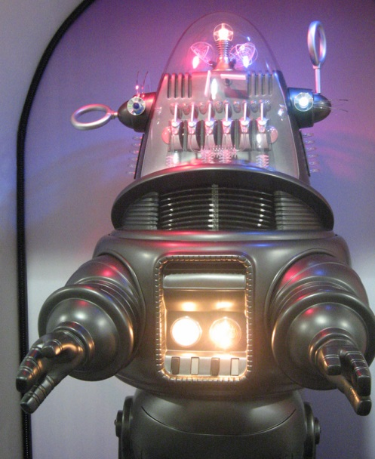
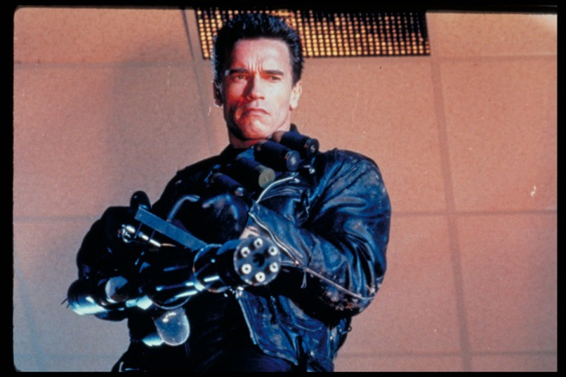
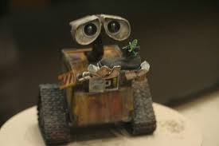
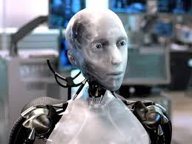
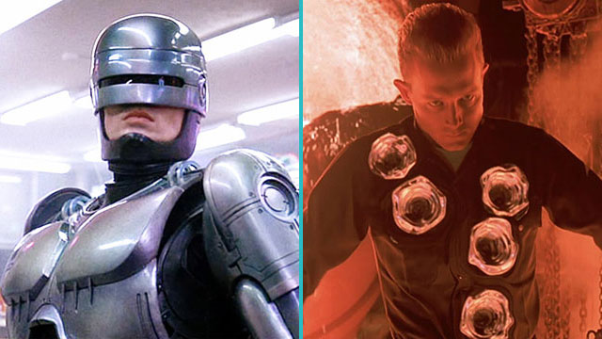
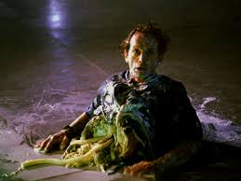
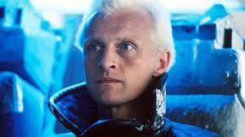
Hollywood’s View

Slide 15
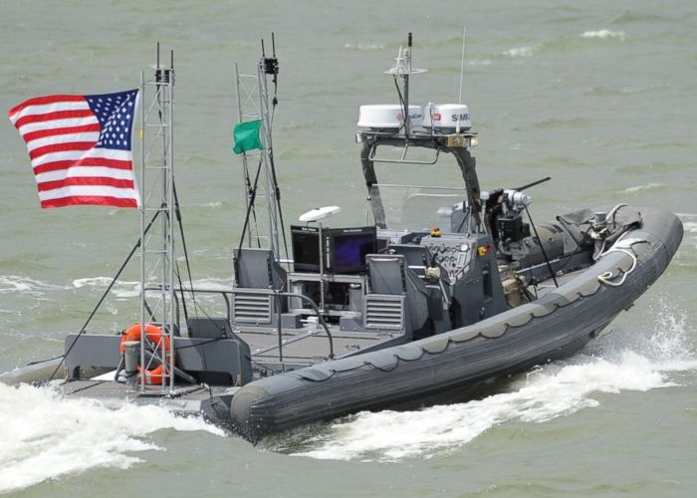
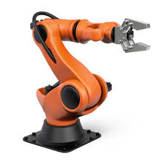
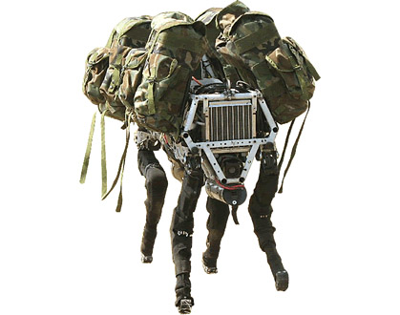
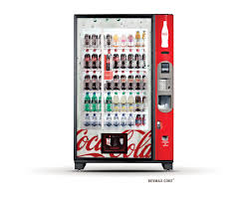
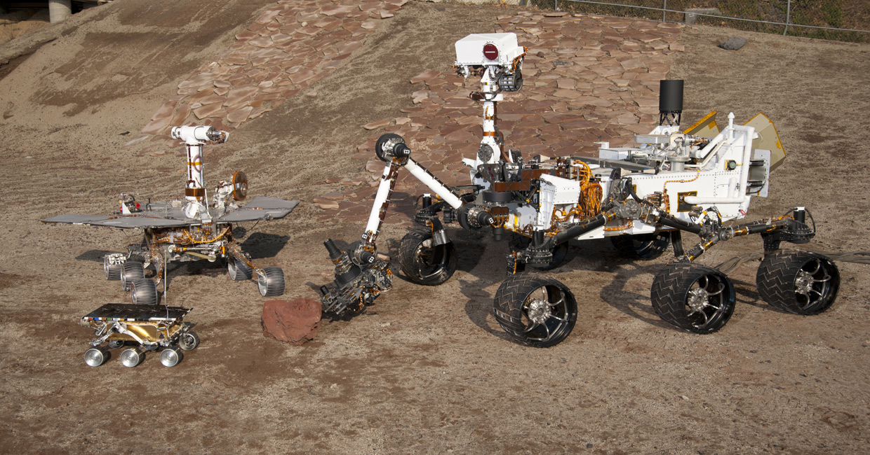
?
Navy ONR: swarm boats
Boston Dynamics: Mule
Spirit
Opportunity
Curiosity
Sojourner
JPL: Mars rovers

